Slide 1
Kubernetes Deep Dive
A Framework for Data Intensive Computing

Slide 2
Agenda
Intro / Prep Environments
Day 1: Docker Deep Dive
Day 2: Kubernetes Deep Dive

Slide 3
Docker Recap
Linux containers
Docker API
Images
Containers
Registry

Slide 4
Docker Recap
Containers run on single Docker host
Containers are ephemeral
Nothing watchdogs the containers
Containers can have external persistence
Containers do not contain
Operating system matters

Slide 5
Why Docker Matters
Application distribution
Dependency management
Application density
Reduced management overhead in terms of VMs
On premise, hybrid, public cloud

Slide 6
Why you Win with Docker-Based Solutions
Immutable infrastructure
DevOps
CI/CD

Slide 7

Enter Kubernetes
Kubernetes is an open-source system for automating deployment, scaling, and management of containerized applications.

Slide 8
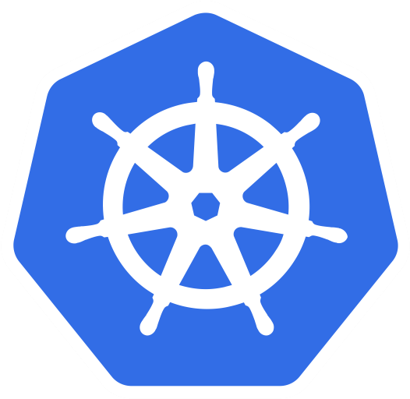
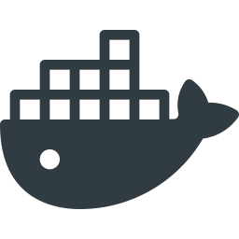
Simple Kubernetes Architecture
Docker Host
Docker Host
Docker Host
Kubernetes
Host

Slide 9
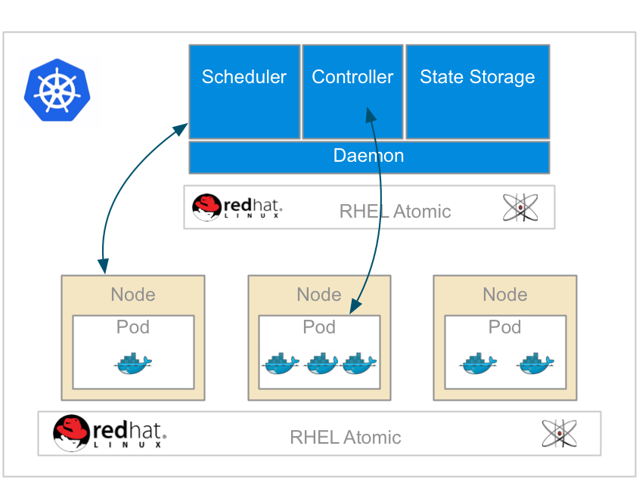
Overall Kubernetes

Slide 10
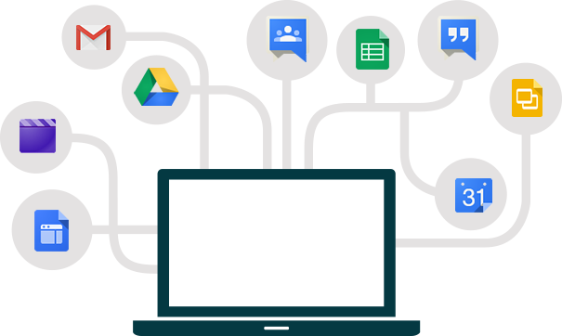

Containerize all the Things
Everything at Google runs in containers!
Everything means, Gmail, search, Google Maps
With over 2 billion containers a week
And of course, Google Cloud Services

Slide 11
What is a Kube?
“Helmsman of a Ship”
Containers at Google
Large-scale cluster management at Google with Borg
Open source 6/2014
GKE…
Red Hat - a top contributor
Written in golang completely
Do we need this?

Slide 12
Kube is Kubernetes
Different way to look at managing instances: scale
Design for failure
Efficient / Lean/ Simple
Portability
Extensible
How to place containers on a cluster
Smart placement
How to interact with a system that does placement

Slide 13
What Does Kubernetes Do?
Different than configuration management
Immutable infrastructure principles
What to do when containers fail?
Containers will fail
Cluster security authZ/authN
Scaling
Grouping/Aggregates

Slide 14
Why is it Important
Managing containers by hand is harder than VMs: It won’t scale
Automate the boilerplate stuff
Runbooks → Scripts → Config management → Scale
Decouple application from machine
Applications run on resources
Kubernetes manages this interaction of applications and resources
Manage applications, not machines
What about legacy apps?

Slide 15
Kubernetes Core Concepts
Simplicity, Simplicity, Simplicity
Pods
Labels / Selectors
Replication Controllers
Services
See the API at http://kubernetes.io/third_party/swagger-ui/
Node
Pod 1
Pod 2
Container
Container

Slide 16
Reconciliation of End State
Cluster
Declare
Make it

Slide 17
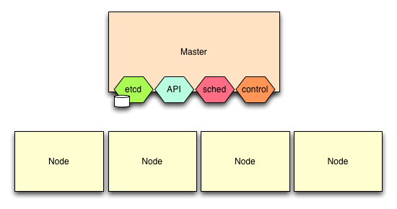
Kubernetes Control Plane
Controller manager
etcd
API Server
Scheduler
Notes:
etcd
API Server
Scheduler
Controller manager

Slide 18
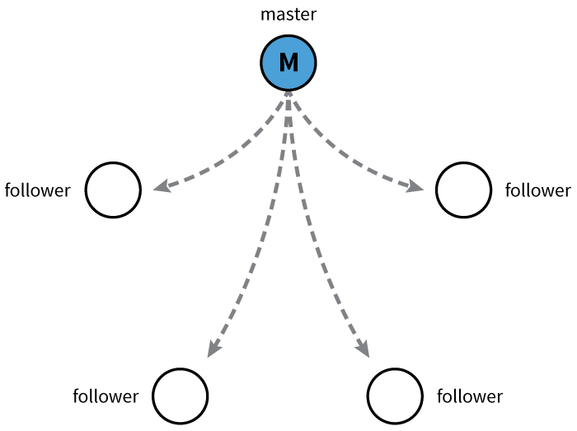
etcd
Open source project started at CoreOS
Distributed database
CAP Theorem? == CP
Raft algorithm/protocol
Watchable
etcd provides HA data store

Slide 19
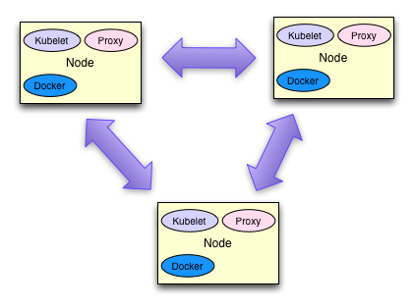
Kubernetes Nodes
Nodes are VMs or physical hosts
Nodes need connectivity between them
Ideally same network, data center, and availability zone

Slide 20
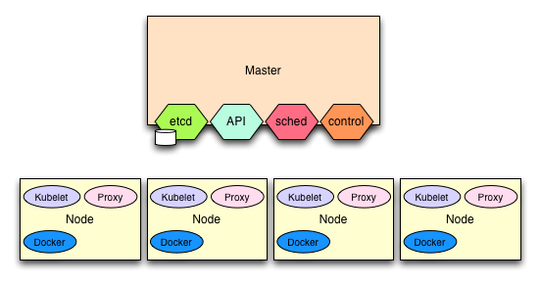
Kubernetes Nodes

Slide 21
Kubernetes Nodes
Kubelet
Watches for pods to be assigned to node
Mount volumes
Install secrets
Runs the pod (via Docker)
Reports pod status / node status
Kube-Proxy
Connection forwarding
Kube services
Docker

Slide 22
Cluster Add-Ons
Monitoring
DNS
UI
Logging

Slide 23
DEMO
Guestbook Demo
https://github.com/kubernetes/kubernetes/blob/release-1.0/examples/guestbook/README.md

Slide 24
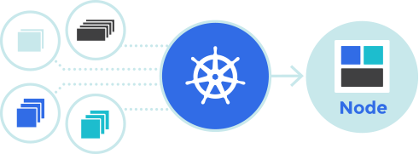
Set up Kubernetes
Lab prerequisites in place – if any
Verify you have most recent version of Oracle‘s VirtualBox
Install Kubernetes
Understand the architecture
Smoke test

Slide 25
Final Output
Waiting for each minion to be registered with cloud provider
Validating we can run kubectl commands.
NAME READY STATUS RESTARTS AGE
Connection to 127.0.0.1 closed.
Kubernetes cluster is running. The master is running at:
https://10.245.1.2
The user name and password to use is located in ~/.kubernetes_vagrant_auth.
calling validate-cluster
Found 1 nodes.
NAME LABELS STATUS
1 10.245.1.3 kubernetes.io/hostname=10.245.1.3 Ready
Validate output:
NAME STATUS MESSAGE ERROR
controller-manager Healthy ok nil
scheduler Healthy ok nil
etcd-0 Healthy {"health": "true"} nil
Cluster validation succeeded
Done, listing cluster services:
Kubernetes master is running at https://10.245.1.2
KubeDNS is running at https://10.245.1.2/api/v1/proxy/namespaces/kube-system/services/kube-dns
KubeUI is running at https://10.245.1.2/api/v1/proxy/namespaces/kube-system/services/kube-ui

Slide 26
Kubernetes Deep Dive
let’s dive deeper now that we know that basics

Slide 27
Kubernetes Core Concepts
Pods
Labels/Selectors
Replication Controllers
Services

Slide 28
Kubernetes Pods
A pod is one or more Docker containers
Ensures collocation and shared fate
Pods are scheduled and do not move nodes
Docker containers share resources within the pod
Volumes
Network / IP
Port space
CPU / Mem allocations
Pod health probes
Readiness
Liveness

Slide 29
Kubernetes Pods
Container
“foo”
Container
“bar”
app=foo-app
env=prod
version-1.0
Area
Namespaces:
Net
IPC
UTC
Volume
Volume
Volume

Slide 30
Kubernetes Pods
Kubernetes Scheduler reads from etcd
Each node is scheduled by the Scheduler
etcd
Kubernetes Scheduler
Pod
Object
Kubernetes REST API
json
or
yaml
node
node
node
node

Slide 31
Pod Probes
Out of the box
Readiness
Liveness
Probe types
ExecAction
TCPSocketAction
HTTPGetAction
Results
Success
Failure
Unknown

Slide 32
Pod Restart Policies
Pods restart on single node
Only replication controller reschedules
RestartPolicy
Always (default)
OnFailure
Never
Applies to all containers in the pod
For replication controllers, only Always applicable

Slide 33
Restart Policies Examples
Pod is Running: 1 container and container exits success
Always: restart container, pod stays Running
OnFailure: pod becomes Succeeded
Never: pod becomes Succeeded
Pod is Running: 1 container and container exits failure
Always: restart container, pod stays Running
OnFailure: restart container, pod stays Running
Never: pod becomes Failed

Slide 34
Restart Policies Examples
Pod is Running: 2 containers and container 1 exits failure
Always: restart container, pod stays Running
OnFailure: restart container, pod stays Running
Never: pod stays Running
When container 2 exits from the above example
Always: restart container, pod stays Running
OnFailure: restart container, pod stays Running
Never: pod becomes Failed

Slide 35
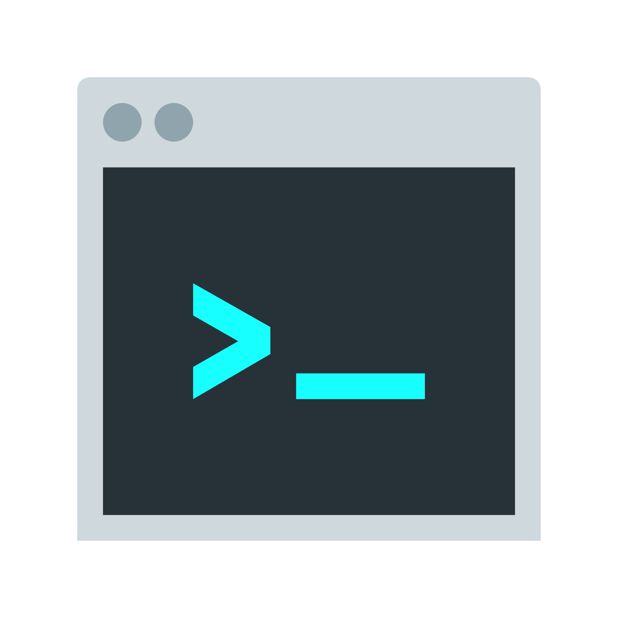
Termination Messages Practices
Help debug problems by putting messages into "termination log"
Default location /dev/termination-log

Slide 36
Your First Pod
apiVersion: v1
kind: Pod
metadata:
labels:
name: influxdb
name: influxdb
spec:
containers:
- image: docker.io/tutum/influxdb:latest
name: influxdb
ports:
- containerPort: 8083
name: admin
protocol: TCP
- containerPort: 8086
name: http
protocol: TCP
Notes:
Let’s take a look at the Kubernetes resource file that we will use and evolve for the purposes of this first hands-on experience.

Slide 37
Deploy the influxdb Pod
You can either copy/paste locally, or download the pod resource file like this:
curl -s -L https://raw.githubusercontent.com/christian-posta/docker-kubernetes-workshop/master/demos/hands-on-pods/influxdb-simple.yaml -O influxdb-simple.yaml
Once you have the file locally downloaded, run the kubectl command (./cluster/kubectl.sh) like this:
kubectl create -f influxdb-simple.yaml

Slide 38
Deploy the influxdb Pod
Wait for the Docker image to download and the pod to start.
We can watch the process, like this:
kubectl get pod --watch
And watch the Docker events in another window, like this:
NOTE: You’ll need to be logged into minion-1 directly to see the Docker events:
docker events

Slide 39
Interact with Your First Kubernetes Pod
Let’s begin interacting by using our describe command, like this:
kubectl describe pod/influxdb
Notes:
Now that we have our first pod up, let’s see where it’s deployed. Note where it’s deployed (Node field).

Slide 40
Interact with Your First Kubernetes Pod
kubectl describe pod/influxdb
Output:
Name: influxdb
Namespace: demo-pods
Image(s): docker.io/tutum/influxdb:latest
Node: 10.245.1.3/10.245.1.3
Labels: name=influxdb
Status: Running
Reason:
Message:
IP: 10.246.1.7
Replication Controllers: <none>
Containers:
influxdb:
Image: docker.io/tutum/influxdb:latest
State: Running
Started: Sun, 18 Oct 2015 17:09:16 -0700
Ready: True
Restart Count: 0
Conditions:
Type Status
Ready True
Events:
<truncated>
Notes:
Now that we have our first pod up, let’s see where it’s deployed. Note where it’s deployed (Node field).

Slide 41
Interact with Your First Kubernetes Pod
Now, let’s try to ping:
Output:
ping 10.246.1.7
PING 10.246.1.7 (10.246.1.7) 56(84) bytes of data.
64 bytes from 10.246.1.7: icmp_seq=1 ttl=63 time=2.43 ms
64 bytes from 10.246.1.7: icmp_seq=2 ttl=63 time=8.41 ms
64 bytes from 10.246.1.7: icmp_seq=3 ttl=63 time=1.27 ms
64 bytes from 10.246.1.7: icmp_seq=4 ttl=63 time=2.23 ms
^C
--- 10.246.1.7 ping statistics ---
4 packets transmitted, 4 received, 0% packet loss, time 3004ms
rtt min/avg/max/mdev = 1.271/3.587/8.411/2.819 ms
Notes:
Let’s login to our minion-1 machine and interact with the pod. We found out which machine the pod was running on in the last slide.
vagrant ssh minion-1
Let’s try ping the pod to see if we can reach it from the minion (we could have also logged into the master and run the same commands; the assumption Kubernetes makes is a flat network reachable from anywhere in the cluster. More on the Kubrentes network model later.

Slide 42
Interact with Your First Kubernetes Pod
Now, let’s issue a command to that IP address.
These commands must be run from either master or minion1:
export INFLUX_NODE=10.246.1.7
curl -G "http://$INFLUX_NODE:8086/query" --data-urlencode "q=CREATE DATABASE kubernetes"
curl -X POST "http://$INFLUX_NODE:8086/write?db=kubernetes" -d 'pod,host=node0 count=10'
curl -G "http://$INFLUX_NODE:8086/query?pretty=true" --data-urlencode "db=kubernetes" --data-urlencode "q=SELECT SUM(count) FROM pod"
Notes:
We add a new database to the influxdb index, then we add some data, and finally we query it. You should see 10 as the result.

Slide 43
Adding Readiness and Liveness Checks
apiVersion: v1
kind: Pod
metadata:
labels:
name: influxdb
name: influxdb
spec:
containers:
- image: docker.io/tutum/influxdb:latest
name: influxdb
readinessProbe:
httpGet:
path: /ping
port: 8086
initialDelaySeconds: 5
timeoutSeconds: 1
...
...
livenessProbe:
httpGet:
path: /ping
port: 8086
initialDelaySeconds: 15
timeoutSeconds: 1
ports:
- containerPort: 8083
name: admin
protocol: TCP
- containerPort: 8086
name: http
protocol: TCP
Notes:
At this point, we’ve deployed our first application on Kubernetes, but it doesn’t do too much. Earlier we discussed the different probe options we have for determining whether a pod is healthy or ready for action. Let’s add some of that to our pod. The pod YAML resource looks like this.

Slide 44
Adding Readiness and Liveness Checks
First, let’s stop and remove our previous influxdb pod since we’ll be re-doing it this time with health-checking:
Curl the pod resource as we did before, like this:
Use the kubectl command line again to create our pod, just like before:
kubectl stop pod/influxdb
curl -s -L https://raw.githubusercontent.com/christian-posta/docker-kubernetes-workshop/master/demos/hands-on-pods/influxdb-readiness.yaml -O influxdb-readiness.yaml
kubectl create -f influxdb-readiness.yaml
Notes:
Now that we’ve deployed our liveness and readiness checks, our Pod is not automatically monitored by kubernetes. If there is ever an issue with it, Kubernetes will kill the pod and depending on its restartPolicy will take action.

Slide 45
Adding Resource Constraints to Our Pods
apiVersion: v1
kind: Pod
metadata:
labels:
name: influxdb
name: influxdb
spec:
containers:
- image: docker.io/tutum/influxdb:latest
name: influxdb
resources:
limits:
cpu: "500m"
memory: "128Mi"
readinessProbe:
httpGet:
path: /ping
port: 8086
...
...
initialDelaySeconds: 5
timeoutSeconds: 1
livenessProbe:
httpGet:
path: /ping
port: 8086
initialDelaySeconds: 15
timeoutSeconds: 1
ports:
- containerPort: 8083
name: admin
protocol: TCP
- containerPort: 8086
name: http
protocol: TCP
Notes:
We have readiness and liveness checks, but we may also want to constrain what the influxdb pod(s) do in terms of isolation and CPU/Memory usage. We don’t want a single pod taking over all of the underlying resources and starving other processes.
Let’s alter our pod yaml resource descriptor to add in resource constraints as above.

Slide 46
Adding Resource Constraints to Our Pods
Let’s stop our previous pod, download the new manifest and run it:
Now, curl the pod resource, just like before:
Use the kubectl command line again to create our pod:
kubectl stop pod/influxdb
curl -s -L https://raw.githubusercontent.com/christian-posta/docker-kubernetes-workshop/master/demos/hands-on-pods/influxdb-resource-limits.yaml -O influxdb-resource-limits.yaml
kubectl create -f influxdb-resource-limits.yaml
Notes:
Now our pod is allocated specific limits so we can sleep at night knowing we have resource isolation.

Slide 47
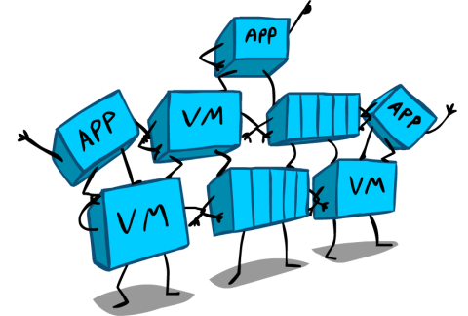
Stateful Containers
emtpyDir
hostpath
gcePersistentDisk
awsElasticBlockStorage
nfs
glusterfs
gitRepo
Notes:
Whenever we add new databases to our influxdb and then stop the pod, we find that the data in the influxdb is not persisted.
Let’s add a way to persist that information. Kubernetes offers a few persistence mechanisms out of the box.

Slide 48
Stateful Containers
Let’s stop our previous pod, download the new manifest and run it:
Now we’re going to create a "claim" for persistent volume space (details explained in class):
curl -s -L https://raw.githubusercontent.com/christian-posta/docker-kubernetes-workshop/master/demos/hands-on-pods/local-persistent-volume.yaml | kubectl create -f -
curl -s -L https://raw.githubusercontent.com/christian-posta/docker-kubernetes-workshop/master/demos/hands-on-pods/local-pvc.yaml | kubectl create -f -
Notes:
In tomorrow’s demo, we’ll show how to use a shared-storage mechanism in Google Compute Engine to create stateful pods. But for now, we’ll just map to a location on the Node/host. Note this has implications about pod rescheduling etc that will discussed in the class.
Let’s create the Kubernetes Persistent Volume.

Slide 49
Stateful Containers
Make sure your influxdb pod is stopped, like this:
Now, deploy your new pod that uses the PersistentVolume:
kubectl stop pod influxdb
curl -s -L https://raw.githubusercontent.com/christian-posta/docker-kubernetes-workshop/master/demos/hands-on-pods/influxdb-local-pv.yaml | kubectl create -f -
Notes:
In tomorrow’s demo, we’ll show how to use a shared-storage mechanism in Google Compute Engine to create stateful pods. But for now, we’ll just map to a location on the Node/host. Note this has implications about pod rescheduling etc that will discussed in the class.
Let’s create the Kubernetes Persistent Volume.

Slide 50
Stateful Containers
Follow along:
export INFLUX_NODE=10.246.1.7
curl -G "http://$INFLUX_NODE:8086/query" --data-urlencode "q=CREATE DATABASE kubernetes"
curl -X POST "http://$INFLUX_NODE:8086/write?db=kubernetes" -d 'pod,host=node0 count=10'
curl -X POST "http://$INFLUX_NODE:8086/write?db=kubernetes" -d 'pod,host=node1 count=9'
curl -X POST "http://$INFLUX_NODE:8086/write?db=kubernetes" -d 'pod,host=node2 count=12'
curl -G "http://$INFLUX_NODE:8086/query?pretty=true" --data-urlencode "db=kubernetes" --data-urlencode "q=SELECT SUM(count) FROM pod"
Notes:
Now let’s figure out what IP address the new influxd pod lives again:
kubectl describe pod/influxdb
And now let’s query/interact with influxdb as shown above.

Slide 51
Stateful Containers
Restart:
And query:
curl -s -L https://raw.githubusercontent.com/christian-posta/docker-kubernetes-workshop/master/demos/hands-on-pods/influxdb-local-pv.yaml | kubectl create -f -
curl -G "http://$INFLUX_NODE:8086/query?pretty=true" --data-urlencode "db=kubernetes" --data-urlencode "q=SELECT SUM(count) FROM pod"
Notes:
Now let’s kill the pod and restart it. We should see the same databases and data in the influxbd even after we restart it:
kubectl stop pod/influxdb
Then, restart it, and query it again.

Slide 52
Pods in Production
Uses PersistentVolumes for stateful pods/containers
Uses Kubernetes secrets to distribute credentials
Leverages readiness and liveness probes
Considesr resources (CPU/Mem) limits and quotas
Uses termination messages

Slide 53
Grouping
Organizing your cluster

Slide 54
Grouping
Decouple application dimensions from infrastructure deployments
Tiers
Release Tracks
Grouping of micro services
Kubernetes clusters are dynamic
Predicated on failure
Need a way to identify groups of services
Be able to add/remove from group on failures
Query-able
Kubernetes Labels

Slide 55
What are Kubernetes Labels?
Arbitrary metadata
Attach to any API object
eg, Pods, ReplicationControllers, Endpoints, etc
Simple Key = Value Assignments
Can be queried with selectors

Slide 56
Label Examples
Release = Stable, Release = Canary
Environment = Dev, Environment = Qa, Environment = Prod
Tier = Frontend, Tier = Backend, Tier = Middleware
Partition = Customer A, Partition = Customer B, Etc.
Used to group “like” objects — no expectation of uniqueness

Slide 57
Keys and Values
The structure of a key:
<prefix>/<name>
example key org.apache.hadoop/partition
Prefix can be up to 253 characters
Name can be up to 63 characters
Values can be ([a-z0-9A-Z]) with dashes (-), underscores (_), dots (.)
Values can be up to 63 characters

Slide 58
Example Labels
version=1.0
com.foo/tier=frontend
version=1.0
com.foo/tier=frontend
version=1.1
com.foo/tier=frontend
node.js/app
node.js/app
node.js/app
environment=pre-pred
com.foo/tier=middleware
environment=pre-pred
com.foo/tier=middleware
jboss fuse
jboss fuse
environment=pre-pred
com.foo/tier=db
environment=pre-pred
com.foo/tier=db
environment=pre-pred
com.foo/tier=db
cassandra
cassandra
cassandra

Slide 59
Selectors for Grouping
Labels are query-able metadata
Selectors can do the queries
Equality based
Environment = Production
Tier != Frontend
Combinations: "tier != frontend, version = 1.0.0"
Set based
Environment in (production, pre-production)
Tier notin (frontend, backend)
Partition

Slide 60
Example Selectors
version = 1.1
version=1.0
com.foo/tier=frontend
version=1.0
com.foo/tier=frontend
version=1.1
com.foo/tier=frontend
node.js/app
node.js/app
node.js/app
environment=pre-pred
com.foo/tier=middleware
environment=pre-pred
com.foo/tier=middleware
Environment in Pre-Prod
jboss fuse
jboss fuse
environment=pre-pred
com.foo/tier=db
environment=pre-pred
com.foo/tier=db
environment=pre-pred
com.foo/tier=db
com.foo/tier = db
cassandra
cassandra
cassandra

Slide 61
Annotations
Attaching useful metadata to objects - not query-able
Data that you want to know to build context - easy to have it close
Author information
Build date/timestamp
Links to SCM
PR numbers/Gerrit patch sets
Annotations are not query-able
Can build up tooling around annotations

Slide 62
What Should you Label and Annotate?
Everything!

Slide 63
Scaling and Ensuring Cluster Invariants

Slide 64
Replication Controllers
Cluster
Declare
Make it

Slide 65
Replication Controllers
Can configure the number of replicas of a pod
Will be scheduled across applicable nodes
Replication controllers can change replica value to scale up/down
Which pods are scaled depends on RC selector
Labels and selectors are the backbone of grouping

Slide 66
Replication Controllers
Can even do complicated things with labels/RCs
Take a pod out of cluster by changing its label
Can have multiple RCs so no SPOF
If a pod is unhealthy
RC can kill and restart

Slide 67
Replication Controller
apiVersion: v1
kind: ReplicationController
metadata:
labels:
app: inspector
track: stable
name: inspector
spec:
replicas: 1
selector:
app: inspector
track: stable
template:
metadata:
labels:
app: inspector
track: stable
...
...
spec:
containers:
- image: b.gcr.io/kuar/inspector:1.0.0
imagePullPolicy: IfNotPresent
name: inspector
resources: {}
terminationMessagePath: /dev/termination-log
dnsPolicy: ClusterFirst
restartPolicy: Always
status:
observedGeneration: 1
replicas: 1

Slide 68
Replication Controller
curl -s -L https://raw.githubusercontent.com/christian-posta/docker-kubernetes-workshop/master/demos/replication-controllers/inspector-rc.yaml | kubectl create -f -
root@server $ kubectl get rc
CONTROLLER CONTAINER(S) IMAGE(S) SELECTOR REPLICAS
inspector inspector b.gcr.io/kuar/inspector:1.0.0 app=inspector,track=stable 1

Slide 69
Scale Up
We want to change the value of the replicas for our inspector replication controller to scale up:
If successful you should see:
Now do a get pods to see
kubectl scale rc inspector --replicas=5
scaled
root@server $ kubectl get pod
NAME READY STATUS RESTARTS AGE
inspector-3sh6q 1/1 Running 0 13m
inspector-5djgp 1/1 Running 0 13m
inspector-9b68m 1/1 Running 0 13m
inspector-ohaod 1/1 Running 0 13m
inspector-r5bqo 1/1 Running 0 19m

Slide 70
Scale Down
Let’s scale the inspector app down to two pods:
kubectl scale rc inspector --replicas=2
Now when you get the pods, there should just be two:
root@server $ kubectl get pod
NAME READY STATUS RESTARTS AGE
inspector-5djgp 1/1 Running 0 13m
inspector-r5bqo 1/1 Running 0 19m
Notes:
Note that Kubernetes decides which ones to kill.

Slide 71
Autoscaling
Ongoing work in the community
https://github.com/kubernetes/kubernetes/blob/master/docs/proposals/autoscaling.md
Use existing monitoring tools to provide scaling

Slide 72
Loadbalancing Service Discovery

Slide 73
You Have Lots of Pods
Pods have their own IP address
Pods can come and go; they’re fungible
Replication controllers maintain replica invariants
So you have lots of Pods and IPs, which do you use?
Use labels for grouping
Kubernetes services does the heavy lifting of finding Pods

Slide 74
Kubernetes Services
Decouple providers and accessors of services
Don’t depend on Pod IPs directly
Need to find pods that match certain selection criteria
mmm… labels and selectors again :)
Pods can live on any node
Use a single IP that doesn’t change
Virtual IP load balancing and discovery

Slide 75
Kubernetes Services
version=1.0
com.foo/tier=frontend
version=1.0
com.foo/tier=frontend
version=1.1
com.foo/tier=frontend
node.js/app
node.js/app
node.js/app
service: db
selector: com..foo/tier=db
environment=pre-pred
com.foo/tier=middleware
environment=pre-pred
com.foo/tier=middleware
jboss fuse
jboss fuse
10.200.4.1
cassandra
cassandra
cassandra
environment=pre-pred
com.foo/tier=db
environment=pre-pred
com.foo/tier=db
environment=pre-pred
com.foo/tier=db

Slide 76
Kubernetes Services
Example:
apiVersion: v1
kind: Service
metadata:
name: inspector
labels:
app: inspector
spec:
type: NodePort
selector:
app: inspector
ports:
- name: http
nodePort: 36000
port: 80
protocol: TCP

Slide 77
Kubernetes Services – No Selectors
Use selectors to locate existing Kubernetes pods
Use a service without selectors to point to external services
DB running outside of Kubernetes
Example:
kind: "Service"
apiVersion: "v1"
metadata:
name: "my-service"
spec:
ports:
-
protocol: "TCP"
port: 80
targetPort: 9376

Slide 78
Kubernetes Services – No Selectors
Endpoint objects will not be created
Will need to make those and point them where you want:
Example:
kind: "Endpoints"
apiVersion: "v1"
metadata:
name: "my-service"
subsets:
-
addresses:
-
IP: "1.2.3.4"
ports:
-
port: 80

Slide 79
How it Works
When a new service and/or endpoint object is created in etcd
Also, kube-proxy opens a port on the node
Connections to that port will be proxy-ed to the pods
And kube-proxy maintains iptables routing from the clusterIP (VIP) to the node port

Slide 80

How it Works
Backend Pod 1
labels: app=MyApp
Port: 9376
Backend Pod 2
labels: app=MyApp
Port: 9376
Backend Pod 3
labels: app=MyApp
Port: 9376
apiserver
kube-proxy
Client

Slide 81
Discovering Services from Collaborators
Example, UI pods need to use DB pods
{svcname}_SERVICE_HOST
{svcname}_SERVICE_PORT
Implies an ordering requirement - service must have been created first
DNS - as a cluster add on (recommended)
{svcname}.{nsname}
e.g.: my-service.my-namespace would be how you find a service in the my-namespace namespace
REDIS_MASTER_SERVICE_HOST=10.0.0.11
REDIS_MASTER_SERVICE_PORT=6379
REDIS_MASTER_PORT=tcp://10.0.0.11:6379
REDIS_MASTER_PORT_6379_TCP=tcp://10.0.0.11:6379
REDIS_MASTER_PORT_6379_TCP_PROTO=tcp
REDIS_MASTER_PORT_6379_TCP_PORT=6379
REDIS_MASTER_PORT_6379_TCP_ADDR=10.0.0.11

Slide 82
Service Types
ClusterIP
Default, create an internal IP that can be used within pods for service discovery
NodePort - open a port on all of the nodes that the service listens on (can be accessed from outside the cluster)
Set type == “NodePort”
Will allocate a port in the default range (can be configured): 30000-32767
Will set spec.ports.nodePort for you
Can set it manually and it will try to use this fixed port, or it will fail
Can then use your own load balancers and point to this specific port (external access)
LoadBalancer — useful for cloud providers that expose external load balancers

Slide 83
Combine Service and RC Resources
kind: "List"
apiVersion: "v1"
items:
- kind: "Service"
apiVersion: "v1"
metadata:
name: "mock"
labels:
app: "mock"
status: "replaced"
spec:
ports:
- protocol: "TCP"
port: 99
targetPort: 9949
selector:
app: "mock"
- kind: "ReplicationController"
apiVersion: "v1"
metadata:
name: "mock"
labels:
app: "mock"
status: "replaced"
spec:
replicas: 1
selector:
app: "mock"
template:
metadata:
labels:
app: "mock"
spec:
containers:
- name: "mock-container"
image: "kubernetes/pause"
ports:
- containerPort: 9949
protocol: "TCP"

Slide 84
Create a Service
Let’s create a service now to play around with:
NOTE: Notice we are piping the results to kubectl
This service exposes to a NodePort on the Node.
To see which port is exposed we can get that info, like this:
curl -s -L https://raw.githubusercontent.com/christian-posta/docker-kubernetes-workshop/master/demos/services/inspector-svc.yaml | kubectl create -f -
kubectl get svc/inspector -o template -t "{{.spec.ports}}"
Notes:
Assuming you still have the replication controller from the previous section, let’s create a service that exposes the inspector app (https://github.com/kelseyhightower/inspector/) directly on the Nodes.
Then you can query the Node (by IP if using vagrant) and the port. If you do this from outside the VMs, make sure to map your VM port to your host.

Slide 85

Output from Inspector Service
Now, what happens when we do the following:
curl –G http://10.245.1.3:30727/

Slide 86
Output from Inspector Service
Output:
<!DOCTYPE html>
<html lang="en">
<head>
<link rel="stylesheet" href="css/bootstrap.min.css">
</head>
<div class="container">
<body>
<h1>Inspector</h1>
<p>
<b>Home</b> |
<a href="./env">Environment</a> |
<a href="./mnt">Mounts</a> |
<a href="./net">Network</a>
</p>
<hr/>
<p>Version: Inspector 1.0.0</p>
</ul>
</body>
</div>
</html>

Slide 87
Output from Inspector Service
That’s now curl /net, like this:
Output:
curl –G http://10.245.1.3:30727/net
<snipped>
<tr>
<td>eth0</td>
<td>02:42:0a:f6:01:0e</td>
<td><ul class="list-unstyled">
<li>10.246.1.14/24</li>
<li>fe80::42:aff:fef6:10e/64</li>
</ul>
</td>
</tr>
</snipped>
Notes:
Try running the curl command pointing to the /net path. For each call we can inspect what network information gets returned.
And if you have more than 1 replica, you should see that network information change as we access different pods behind the service (load balanced)

Slide 88
Lab

Slide 89
End of Chapter

